Slide 1
Multiple Choice Questions
Operators

Slide 2
1. What is the output of this C code?
int main()
{
int i = 5;
int L = i / -4;
int k = i % -4;
printf("%d %d\n", L, k);
return 0;
}
A. Compile time error
B. -1 1
C. 1 -1
D. Run time error
Answer: B

Slide 3
2. What is the output of this C code?
void main()
{
int x = 4 *5 / 2 + 9;
}
A. 6.75
B. 1.85
C. 19
D. 3
Answer: C

Slide 4
3. What is the output of this C code?
#include <stdio.h>
void main()
{
int a = 3;
int b = ++a + a++ + --a;
printf("Value of b is %d", b);
}
a) Value of x is 12
b) Value of x is 13
c) Value of x is 10
d) Undefined behaviour
Answer: D

Slide 5
4. What is the precedence of arithmetic operators (from highest to lowest)?
a) %, *, /, +, –
b) %, +, /, *, –
c) +, -, %, *, /
d) %, +, -, *, /
Answer: A

Slide 6
5. What is the output of this C code?
#include <stdio.h>
void main()
{
int x = 1, y = 0, z = 5;
int a = x && y || z++;
printf("%d", z);
}
a) 6
b) 5
c) 0
d) Varies
Answer: A

Slide 7
6. What is the output of this C code?
#include <stdio.h>
int main()
{
int i = 3;
printf("%d", (++i)++);
return 0;
}
(A) 3
(B) 4
(C) 5
(D) Compile-time error
Answer: D
In C, prefix and postfix operators need l-value to perform operation and return r-value. The expression (++i)++ when executed increments the value of variable i(i is a l-value) and returns r-value. The compiler generates the error(l-value required) when it tries to post-incremenT the value of a r-value.

Slide 8
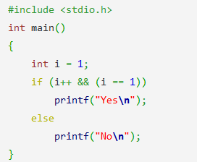
7. What is the output of this C code?
a) Yes
b) No
c) Depends on the compiler
d) Depends on the standard
Answer: B

Slide 9
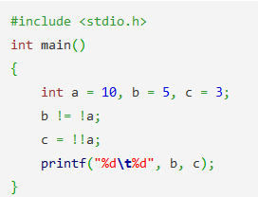
8. What is the output of this C code?
a) 5 1
b) 0 3
c) 5 3
d) 1 1
Answer: A

Slide 10
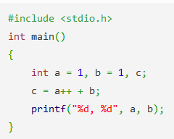
9. What is the output of this C code?
a) a = 1, b = 1
b) a = 2, b = 1
c) a = 1, b = 2
d) a = 2, b = 2
Answer: B

Slide 11
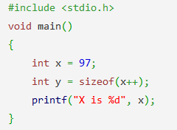
10. What is the output of this C code?
a) X is 97
b) X is 98
c) X is 99
d) Run time error
Answer: A

Slide 12
11. What will be the output of following program ?
#include <stdio.h>
void main()
{
int x=(20 || 40 ) && (10);
printf("x= %d",x);
}
x= 60
x= 70
x= 0
x= 1
Answer: D

Slide 13
12. What will be the output of following program ?
#include <stdio.h>
void main()
{
int a=3,b=2;
a=a==b==0;
printf("%d,%d",a,b);
}
1,2
3,2
0,0
2,3
Answer: A
Since the associability is left to right for == operator, thus (a==b) is evaluated first which results in 0 as a =3 & b=2
Now 0==0 which assigns 1 to a
Thus finally a=1 & b=2

Slide 14
13. What will be the value of x and y ?
#include <stdio.h>
int main()
{
int x,y;
x=(100,200);
y=100,200;
printf("x=%d,y=%d",x,y);
return 0;
}
x=100,y=200
x=200,y=200
ERROR
x=200,y=100
Answer: D
In expression x=(100,200); 200 will be assigned to x because () has precedence over = and , operators. Hence () will be evaluated first and value 200 is assigned to x since ',' has left to right associativity. On the other hand, for expression y=100,200; here priority of = is higher than ',' operator so 100 will be assigned to y.

Slide 15
14. What will be the output of following program ?
#include <stdio.h>
int main()
{
int var;
var=- -10;
printf("value of var= %d\n",var);
var=+ +10;
printf("value of var= %d\n",var);
return 0;
}
ERROR
value of var= -10
value of var= 10
value of var= 10
value of var= 10
value of var= 10
value of var= 11
Answer: C
Here unary minus (or negation) operator is used twice. According to the math rules:
-10 = 10
+ +10=10

Slide 16
15. What will be the output of following program ?
#include <stdio.h>
void main()
{
int intVar=20,x;
x= ++intVar, intVar++, ++intVar;
printf("Value of intVar=%d, x=%d",intVar,x);
}
Value of intVar=23, x=21
Value of intVar=23, x=23
Value of intVar=21, x=21
ERROR
Answer: A
Since assignment operator (=) has more precedence than comma operator, so = operator will be evaluated first.
Here, x = ++intVar, intVar++, ++intVar;
++intVar will be assigned to x then comma operator will be evaluated.

